Slide 1

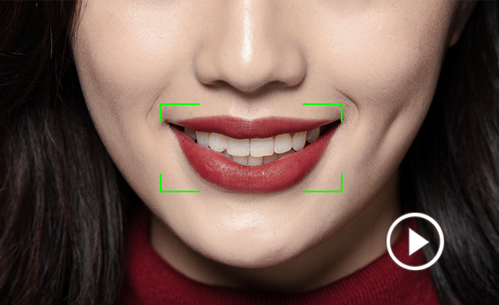
IITI SOC' 23
LIP
READING
By : TEAM ML-1

Slide 2

How Lip Reading Works
Introduction to Lip Reading
Visual cues from the speaker's mouth, tongue, and teeth movements are used to decipher the spoken words.
Importance of Lip Reading
Lip reading is a fundamental communication skill for the hearing and speech
impaired and in noisy environments.

Slide 3
AI/ML TECHNOLOGY IN
LIP READING
01
02
03
Convolutional Neural Networks
CNNs are used to identify and track key lip points, which are then used to generate a sequence of visual features of the spokenwords.
Recurrent Neural Networks
RNNs analyze the sequence of visual features generated by CNNs and use language models to classify the spokenwords
Deep Learning
Deep learning frameworks, such as TensorFlow is used to train the CNNs and RNNs and achieve high accuracy rates with large amounts of data

Slide 4

OVERVIEW
This project is used to recognize spoken words and sentences only from visual lip movements captured in video sequences.
We have trained our model on word level, i.e. we have grouped images from one word and have provided them as inputs into our model

Slide 5
Data
Collection
Image Preprocessing
We have used Grid Corpus dataset.
It has 34 speakers(18 males, 16 females), out of which we have used data from 10 speakers in total.
It includes 34000 sentences of the form "put red at g 9 now".
We have captured the frames from the videos using cv2.
We have then resized the the extracted images to the size (224,224,3) .

Slide 6

APPROACHES USED
Character level training
word level training
dlib library
ResNet50
Haarcascade
VGG-16(Final approach)

Slide 7


Character-level training
The alignment preprocessing of this model is based in the LipNet research paper.
It reads the align file one word at a time and maps each character to a number.
It predicted one character from each frame and decoded that characters to sentence spoken
We tried both dlib and haarcascade libraries for feature extraction.

Slide 8
Problems with the model
Uncertainity in time taken for training.
The poor performance of the final model was probably due to the poor feature extraction tendency of the model.
Because of the poor results obtained from this model we searched for better feature extractors.

Slide 9


Final Model
The final model included word to word approach. It draws the desirable number of frames for one word preprocessed. The features are then extracted using the VGG16 face model and are saved
VGG16 model performed effective feature extraction. These learned features can effectively represent facial characteristics and patterns, making it well-suited for face-related tasks like face recognition, facial expression analysis, and face attribute detection.

Slide 10

MODEL AND ITS ARCHITECTURE
The CNN RNN arhitecture was then used to train model on feature extracted from vgg16 face model .
This architecture was able to handle temporal and spacial data.
This model reduced the time for training.
loss used categorical_crossentropy
optimizer used Adam
metrics :accuracy

Slide 11
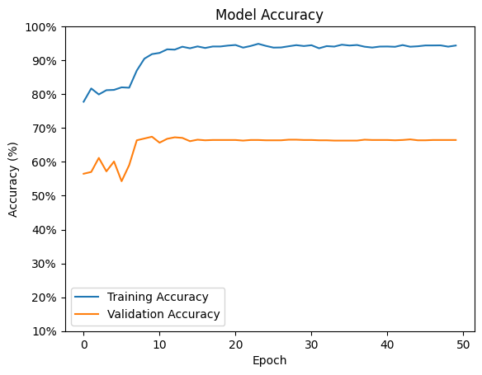
RESULTS
1.accuracy: 94.37%
2.val accuracy : 66.43%
3.epoch = 50
4.batch size = 64

Slide 12
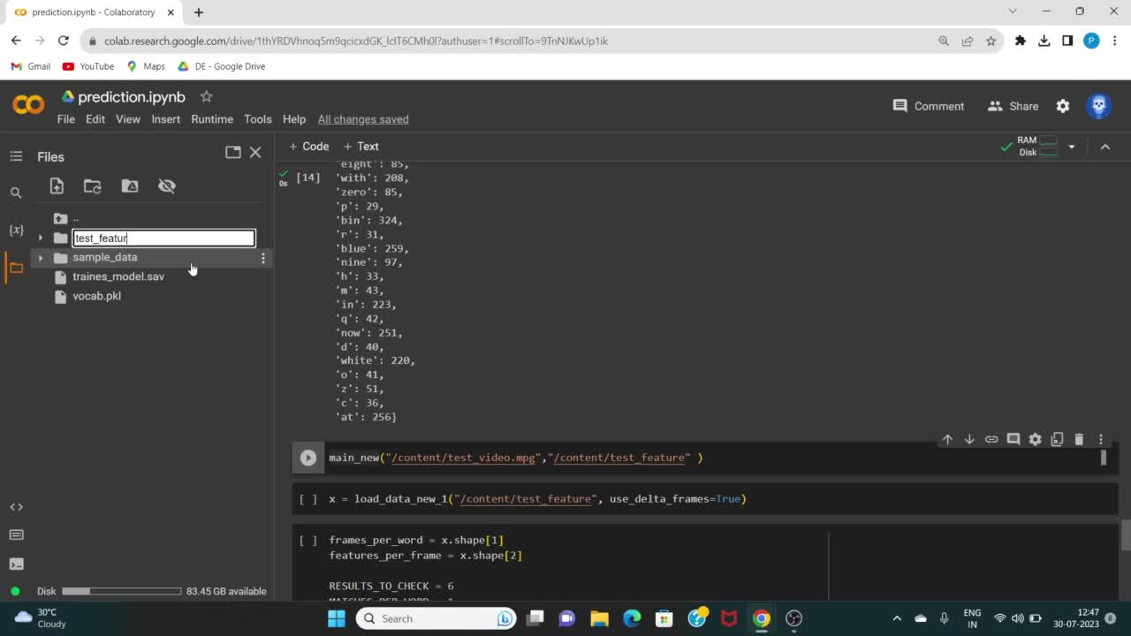
Demo Video

Slide 13

Future aims to develop the project
More vocabulary
Our project can be trained on a wider variety of vocabulary to achieve better accuracy.
Provide subtitles
We can create a user-friendly real-time website to provide subtitles for silent videos.
Multiple faces
We should train our model accurately to interpret lip movements from multiple speakers in one video.
Multi-lingual
We can enhance the model's capabilities to handle diverse linguistic characteristics.

Slide 14
Conclusion
The lip-reading model we created, which uses LSTM and VGGFace features, is doing well at recognizing words from lip movements.
Despite the progress made,there is still scope for improving the model to make it even better and more reliable.

Slide 15

Thank You!
Guided by : Prajakta Darade,
Tanisha Sahu(Mentors)
Presented By: Harshita Bankure,
Tanushree Dewangan,
Prachi Patil.

